Slide 1
Combinatorial Testing
Presenters:
M. Ahmed Bin Alam Rao
M. Shazil Bin Alam Rao

Slide 2
What is Combinatorial Testing?
Combinatorial testing is a testing technique in which multiple combinations of the input parameters are used to perform testing of the software product. The aim is to ensure that the product is bug-free and can handle different combinations or cases of the input configuration.
One of the most commonly used combinatorial testing methods is the pairwise testing technique which involves testing all pairs of input variable values.

Slide 3
Pairwise Testing
Pairwise testing is a type of Combinatorial Testing (CT).
It was also known as ‘All-pairs testing’.
Pairwise testing finds about 50% to 90% of flaws.
It is a black-box test design technique in which test cases are design to execute all possible discrete combinations of each pair of input parameters.
Tools for pairwise Testing: PICT, ACTS, IBM FOCUS,

Slide 4
Why CT is Used?
Because of following reasons we use CT,
One main advantage is to reduce number of test cases for execution.
Since the number of test cases are reduced, the time taken to execute the test suite comes out to be less due to its small size.
Test coverage is increased (up to 100 percent).
Enhanced quality of the product as test coverage is increased

Slide 5
Example(1)
Let say we have car ordering application which includes Buying and Selling cars, it should support trading in Delhi and Mumbai, it should have registration number which may be valid or invalid, it should allow the trade of following cars: BMW, Mercedes, Audi. Two types of booking can be done: E-booking and In Store. And orders can be placed only during trading hours.
Step#1
Order Category
Buy
Sell

Slide 6
Example (1) Contd.
Location
Delhi
Mumbai
Car brand
BMW
Mercedes
Audi
Registration Numbers
Valid(5000)
Invalid
Order Type
E-Booking
In store
Order Time
Working Hours
Non-Working Hours

Slide 7
Example (1) Contd.
If we want to test all the possible valid combination :
2*2*3*5000*2*2
240000 there are also an infinite number of invalid combinations.
Step#2
Use groups and boundaries.
Reduce Registration numbers to two
Valid registration number
Invalid registration number
Now the possible combination is:
2*2*3*2*2*2=96

Slide 8
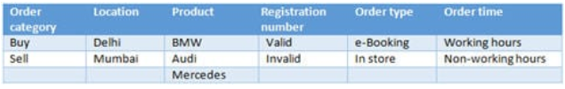

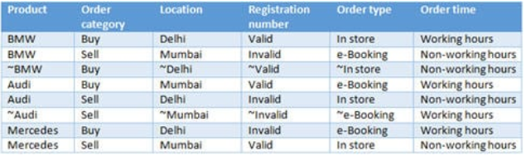
Example (1) Contd.
Step#03
Step#04
Now all pairs in 8 cases, instead of all combinations

Slide 9
Example 2
In this example we have three parameters which can have following values as,
A, B, C;
1, 2;
X, Y
which means that the number of combinations 3 x 2 x 2 = 12. If we want to test just 2-pairs or pairwise testing which covers every possible combination of two parameters.

Slide 10
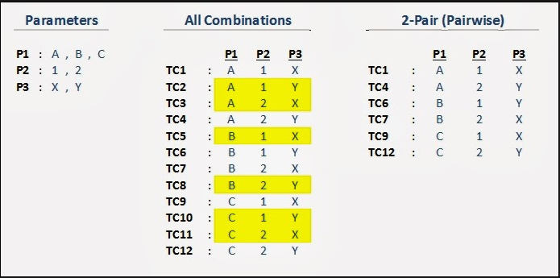
Example (2) Contd.
There should be 6 combinations.
The highlighted test cases TC2, TC3, TC5, TC8, TC10, TC11 are not necessary.

Slide 11

Example (3)
Suppose we have a system with on-off switches:

Slide 12
Example (3) Contd.
34 switches = 2^34 = 1.7 x 10^10
possible inputs = 1.7 x 10^10 tests
If only 3-way interactions, need only 33 tests.
A THREE WAY INTERACTION means that the interaction among the two factors (A * B) is different across the levels of the third factor (C). If the interaction of A * B differs a lot among the levels of C then it sounds reasonable that the two way interaction A * B should not appear as significant.

Slide 13
Example (3) Contd.
To put it another way: A two way interaction A * B exists in reality along with a three order interaction A * B * C only. If the way that the factors A and B interacts among the levels of the factor C is similar.

Slide 14
Example (4)
Let say we have,
X = a, b, c
Y = alpha, Beta, Gamma
Z = 1, 2, 3
Which means that the number of combinations 3 * 3 * 3 = 27
So the number of test cases are 27

Slide 15
Example (4) Contd.
Using Pairwise Testing, the pairs should be,
a, alpha, 1
a, beta, 2
a, gamma, 3
b, alpha, 2 (Because alpha, 1 is already tested)
b, beta, 1
b, alpha, 3

Slide 16
Example (4) Contd.
7. c, gamma, 1
8. c, beta, 3
c, gamma, 2
Hence Test Cases were reduce to 9

Slide 17
THANK YOU

